Slide 1
Java Capability
Day 4 Java

Slide 2
Agenda
Analyze when to use interface in Java programs.
Polymorphism and its concept.
Abstract classes and features.
Understand interface.
Difference between abstract class and interface.
Inner Classes

Slide 3
Prerequisites
Understanding of OOP

Slide 4
Inheritance
Inheritance in java is a mechanism in which one object acquires all the properties and behaviors of parent object.
Inheritance in java is that you can create new classes that are built upon existing classes.
Inheritance represents the IS-A relationship, also known as parent-child relationship.
Terms used in Inheritance
Class : It is a template or blueprint from which objects are created.
Subclass is a class which inherits the other class. It is also called a derived class, extended class, or child class.
Superclass is the class from where a subclass inherits the features. It is also called a base class or a parent class.

Slide 5
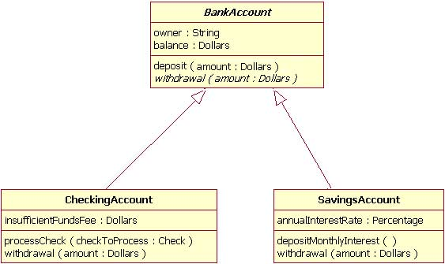
Inheritance
Syntax of Java Inheritance
class Subclass-name extends Superclass-name
{
//methods and fields
}
Except Object, which has no superclass, every class has one and only one direct superclass (single inheritance).
The extends keyword indicates that you are making a new class that derives from an existing class.

Slide 6
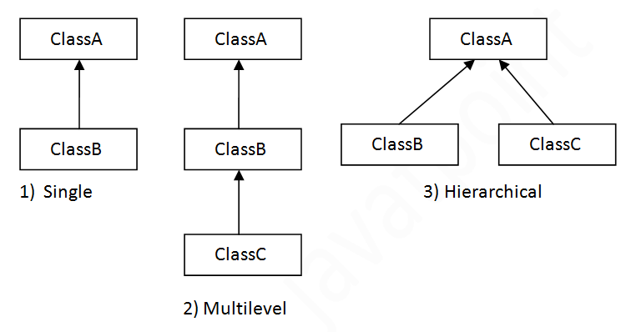
Types of inheritance in java
There can be three types of inheritance in java: single, multilevel and hierarchical.
Multiple inheritance is not supported in java through class.

Slide 7
Inheritance example
class Employee {
void employeeDetails() {
System.out.println(“Employee Details..");
}
}
class Manager extends Employee {
void managerDetails() {
System.out.println(“Manager Details..");
}
}
public class Main {
public static void main(String args[]) {
Manager manager = new Manager();
manager.managerDetails();
manager.employeeDetails();
}
}

Slide 8
Super Keyword
The keyword super can be used to access any data member or methods of the parent class.
Super keyword can be used at variable, method and constructor level.
Syntax : super.<method-name>();

Slide 9
Demo
//Parent class or Superclass or base class
class Superclass
{
int num = 100;
}
//Child class or subclass or derived class
class Subclass extends Superclass
{
int num = 110; // The same variable num is declared in superclass
void printNumber(){
System.out.println(num);
}
public static void main(String args[]){
Subclass subObj= new Subclass();
subObj.printNumber(); // 110
}
}

Slide 10
Accessing variable of parent class
Syntax : super.variable_name
class Superclass
{
int num = 100;
}
class Subclass extends Superclass
{
int num = 110;
void printNumber(){
System.out.println(super.num); // refers parent variable
}
public static void main(String args[]){
Subclass subObj= new Subclass();
subObj.printNumber(); // 100
}
}

Slide 11
super keyword to invoke constructor of parent class
When we create the object of sub class, the new keyword invokes the constructor of child class, which implicitly invokes the constructor of parent class.
class ParentClass
{
ParentClass( ){
System.out.println("Constructor of parent class");
}
}
class SubClass extends ParentClass
{
SubClass( ){
super( );
System.out.println("Constructor of child class");
}
}
public static void main(String args[]){
SubClass obj= new SubClass();
}
}

Slide 12
super keyword in case of method overriding
A child class declares a same method which is already present in the parent class then this is called method overriding.
class ParentClass
{
//Overridden method
void display(){
System.out.println("Parent class method");
}
}
class SubClass extends ParentClass
{
//Overriding method
void display(){
System.out.println("Child class method");
}
void printMsg(){
super.display();
}

Slide 13
super keyword in case of method overriding
public static void main(String args[]){
SubClass subObj= new SubClass();
subObj.display();
subObj.printMsg();
}
}

Slide 14
Conversion and casting
A subclass object reference can be converted to super class object reference automatically. But for the reverse, casting is required.
Automatic conversion example
Only members of ParentClass class are accessible
ParentClass parentClass = new ChildClass();
parentClass.parentMethod( ); //ok
parentClass.childMethod( ); //error
Casting conversion example
ChildClass childObj=(ChildClass) parentClass;
childObj.childMethod(); //ok
Dangers of casting: if the original object is not of subclass type then a runtime exception will be thrown on accessing subclass methods.
// Runtime error-ClassCastException.

Slide 15
protected access modifier
The protected access modifier is accessible within package and outside the package but through inheritance only.
The protected access modifier can be applied on the data member, method and constructor.
It can't be applied on the class.
Same as default access specifier.

Slide 16
Protected - demo
Step 1 : package pack;
public class A{
protected void msg( ){ System.out.println("Hello");}
}
Step 2 : package mypack; // Different package
import pack.A;
class B extends A{
public static void main(String args[]){
B obj = new B();
obj.msg();
}
}

Slide 17
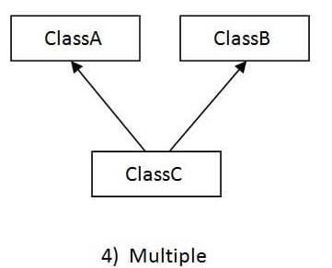
Why multiple inheritance is not supported in java?
Consider a scenario where A, B and C are three classes. The ‘C’ class inherits ‘A’ and ‘B’ classes. If A and B classes have same method and you call it from child class object, there will be ambiguity to call method of A or B class.

Slide 18
polymorphism
Polymorphism is one of the OOPs features.
Polymorphism in java is a concept by which we can perform a single action by different ways.
Polymorphism means many forms.
There are two types of polymorphism in java:
Compile time polymorphism and
Runtime polymorphism.
We can perform polymorphism in java by method overloading and method overriding.

Slide 19
Runtime Polymorphism in Java
Runtime polymorphism or Dynamic Method Dispatch is a process in which a call to an overridden method is resolved at runtime rather than compile-time.
An overridden method is called through the reference variable of a superclass.
Ex :
class A{ }
class B extends A{ }
A a=new B( ); //upcasting

Slide 20
Types of Polymorphism
CompileTime Polymorphism or Static Polymorphism
Method Overloading
Constructor Overloading
Runtime Polymorphism or Dynamic Method Dispatch or Dynamic Polymorphism
Method Overriding

Slide 21
Method Overloading
If a class has multiple methods having same name but different in parameters, it is known as Method Overloading.
If we have to perform only one operation, having same name of the methods increases the readability of the program.
Different ways to overload the method
There are two ways to overload the method in java
By changing number of arguments
By changing the data type
Note : Method Overloading is not possible by changing the return type of
the method only.
class Calculator{
public int add(int num1,int num2){ return num1+ num2 ;}
public double add(int num1,int num2){return num1 + num2 ; }
} // Compile Time Error: method add(int,int) is already defined in class Calculator

Slide 22
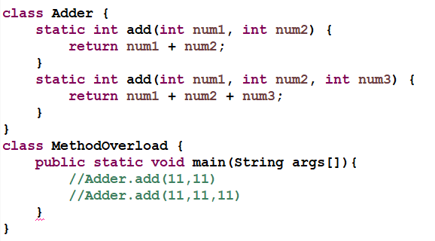
Example for Method Overloading

Slide 23
Constructor Overloading
Constructor overloading is a technique in Java in which a class can have any number of constructors that differ in parameter lists.
The compiler differentiates these constructors by taking into account the number of parameters in the list and their type.

Slide 24
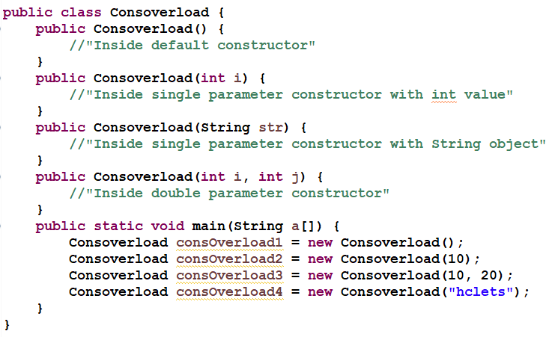
Example

Slide 25
Method Overriding
When a method in a sub class has same name, same number of arguments and same type signature as a method in its super class, then the method is known as overridden method.
Method overriding is also referred to as runtime polymorphism.
Rules for Java Method Overriding
Method must have same name as in the parent class
Method must have same parameter as in the parent class.
Must be IS-A relationship (inheritance).

Slide 26
Real example of Java Method Overriding

Slide 27
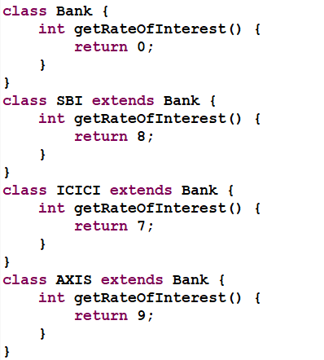
Method Overriding cont.

Slide 28
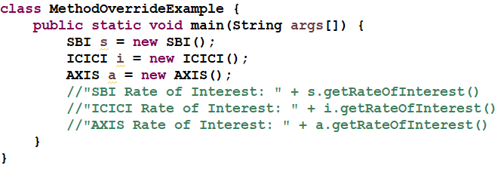
Method Overriding cont.

Slide 29
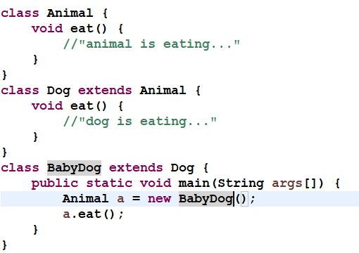
Dynamic Method Dispatch

Slide 30
Dynamic Method Dispatch cont.
When an overridden method is called through a reference of parent class, then type of the object determines which method is to be executed. Thus, this determination is made at run time.
Since both the classes, child class and parent class have the same method eat. Which version of the method(child class or parent class) will be called is determined at runtime by JVM.
In the above program the method of child class is to be executed because which method is to be executed is determined by the type of object and since the object belongs to the child class, the child class version of eat() is called.

Slide 31
@Override
When overriding a method, @Override annotation could be used.
This tells the compiler that you intend to override a method in the superclass.
If, for some reason, the compiler detects that the method does not exist in one of the superclasses, it will generate an error.
@Override
public void display( ){
System.out.println("Name “ + getName());
System.out.println("Date of appointment “ + dateOfAppointment);
}

Slide 32
Covariant return types in Java
Java 5.0 onwards it is possible to have different return type for a overriding method in child class, but child’s return type should be sub-type of parent’s return type.
// Two classes used for return types.
Step 1 : class A { }
class B extends A { }
Step 3 : public class Main {
public static void main(String args[ ])
{
Base base = new Base();
base.fun();
Derived derived = new Derived();
derived.fun();
}
}
class Base // step 2
{
A fun()
{
System.out.println("Base fun( )");
return new A( );
}
}
class Derived extends Base
{
B fun( ) // return type is sub-type of parent
{
System.out.println("Derived fun( )");
return new B( );
}
}

Slide 33
Can we overload static methods?
We can have two or more static methods with same name, but differences in input parameters.
public class Test {
public static void foo() {
System.out.println("Test.foo() called ");
}
public static void foo(int a) {
System.out.println("Test.foo(int) called ");
}
public static void main(String args[])
{
Test.foo();
Test.foo(10);
}
}
Note : We cannot overload two methods in Java if they differ only by static keyword (number of parameters and types of parameters is same)

Slide 34
abstract classes
Declaring a class as an abstract class prevents you from creating instances of that class but they can be subclassed..
Abstract methods are the methods that don’t have the method body. They are just declarations
While an abstract class can have abstract methods, it could also NOT have any abstract methods.
The whole class must be declared abstract, even if a single method is abstract.
An abstract method must not be static.
A class can inherit from abstract class either by complete or partial Implementation. In the case of partial implementation, the class should be marked abstract.

Slide 35
abstract classes
Abstraction is a process of hiding the implementation details and showing only functionality to the user.
Abstract class in Java
Syntax : abstract class A{ }
Abstract method
abstract void printStatus( ); //no body and abstract

Slide 36
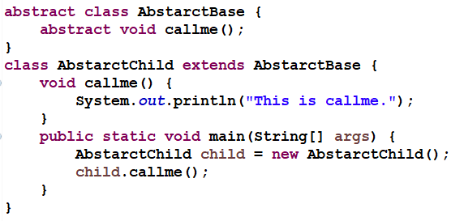
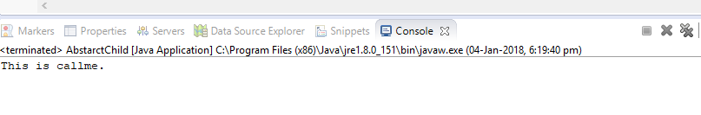
Abstract Class Example
Output:

Slide 37
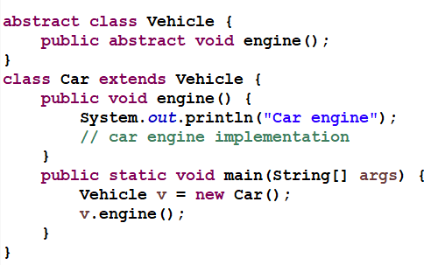

Abstract Class Example
Output:

Slide 38
Abstract Class Example
abstract class Bank{
abstract int getRateOfInterest();
}
class SBI extends Bank{
int getRateOfInterest(){return 7;}
}
class PNB extends Bank{
int getRateOfInterest(){return 7;}
}
class TestBank{
public static void main(String args[]){
Bank bank=new SBI();//if object is PNB, method of PNB will be invoked
int interest=bank.getRateOfInterest();
System.out.println("Rate of Interest is: “ + interest + " %“ );
}}

Slide 39
Object class in Java
The Object class is the parent class of all the classes in java by default.
In other words, it is the topmost class of java.
To refer any object whose type is unknown we can cast to Object class.

Slide 40
Methods of Object class
Method | Description
public final Class getClass() | returns the Class class object of this object. The Class class can further be used to get the metadata of this class.
public int hashCode() | returns the hashcode number for this object.
public boolean equals(Object obj) | compares the given object to this object.
protected Object clone() throws CloneNotSupportedException | creates and returns the exact copy (clone) of this object.
public String toString() | returns the string representation of this object.
public final void notify() | wakes up single thread, waiting on this object's monitor.
public final void notifyAll() | wakes up all the threads, waiting on this object's monitor.
public final void wait(long timeout)throws InterruptedException | causes the current thread to wait for the specified milliseconds, until another thread notifies (invokes notify() or notifyAll() method).
public final void wait(long timeout,int nanos)throws InterruptedException | causes the current thread to wait for the specified milliseconds and nanoseconds, until another thread notifies (invokes notify() or notifyAll() method).
public final void wait()throws InterruptedException | causes the current thread to wait, until another thread notifies (invokes notify() or notifyAll() method).
protected void finalize()throws Throwable | is invoked by the garbage collector before object is being garbage collected.

Slide 41
Interface
The interface in java is a mechanism to achieve abstraction.
Interfaces can have methods and variables but the methods declared in interface contain only method signature, not body or pure abstract methods.
Interface cannot be instantiated like abstract class.
Interface is declared by using interface keyword.
All the methods in interface are declared with empty body and are public and all fields are public, static and final by default.
A class that implement interface must implement all the methods declared in the interface.

Slide 42
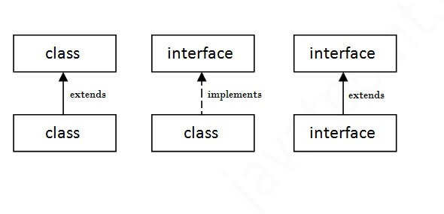
Interface
interface <interface_name>{
// declare constant fields default public, static and final
// declare methods that abstract by default.
}
An interface extends another interface but a class implements an interface.

Slide 43
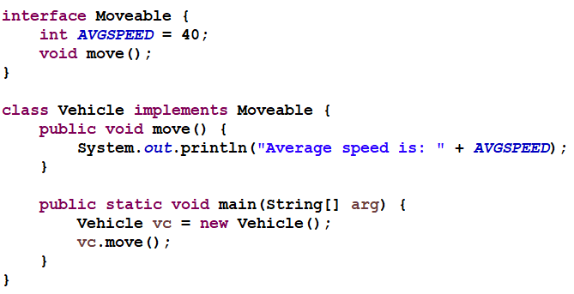

Interface Example Cont.
Output:

Slide 44
Multiple inheritance
interface Printable{
void print();
}
interface Showable{
void print();
}
class TestInterface implements Printable, Showable{
public void print( ){ System.out.println(“print method") ; }
public static void main(String args[]){
TestInterface testInterface = new TestInterface();
testInterface.print(); // print method
}
}

Slide 45
Marker interfaces
Interfaces that do not have any methods or constants are called Marker interfaces.
Marker interfaces are used to tag a class so that the class is of the interface type.
Some examples of marker interface in JSE are:
Cloneable
Serializable
Remote

Slide 46
Java 8 Default Method in Interface
Java 8, we can have method body in interface. But we need to make it default method.
interface Drawable{
void draw();
default void msg( ) { System.out.println ("default method"); }
}
class Rectangle implements Drawable{
public void draw( ) { System.out.println ("drawing rectangle"); }
}
class TestInterfaceDefault{
public static void main(String args[]){
Drawable drawable=new Rectangle();
drawable.draw( ); // drawing rectangle
drawable.msg( ); // default method
}}

Slide 47
Difference between abstract class and interface
Abstract class | Interface
1) Abstract class can have abstract and non-abstract methods. | Interface can have only abstract methods. Since Java 8, it can have default and static methods also.
2) Abstract class doesn't support multiple inheritance. | Interface supports multiple inheritance.
3) Abstract class can have final, non-final, static and non-static variables. | Interface has only static and final variables.
4) Abstract class can provide the implementation of interface. | Interface can't provide the implementation of abstract class.
5) The abstract keyword is used to declare abstract class. | The interface keyword is used to declare interface.
6) An abstract class can extend another Java class and implement multiple Java interfaces. | An interface can extend another Java interface only.
7) An abstract class can be extended using keyword ?extends?. | An interface class an be implemented using keyword implements.
8) A Java abstract class can have class members like private, protected, etc. | Members of a Java interface are public by default.
9)Example: public abstract class Shape{ public abstract void draw(); } | Example: public interface Drawable{ void draw(); }

Slide 48
Inner Classes
Java inner class or nested class is a class which is declared inside the class or interface.
Inner classes can access all the members of outer class including private data members and methods.
class Outer_class{
//code
class Inner_class{
//code
}
}

Slide 49
Inner Classes
Inner class is a part of nested class.
Non-static nested classes are known as inner classes.
Types of Nested classes
There are two types of nested classes non-static and static nested classes.
Non-static nested class (inner class)
Member inner class
Anonymous inner class
Local inner class
Static nested class

Slide 50
Inner Classes
Type | Description
Member Inner Class | A class created within class and outside method.
Anonymous Inner Class | A class created for implementing interface or extending class. Its name is decided by the java compiler.
Local Inner Class | A class created within method.
Static Nested Class | A static class created within class.
Nested Interface | An interface created within class or interface.

Slide 51
References & Further Studies
https://docs.oracle.com/javase/tutorial/java/concepts/interface.html

